Slide 1
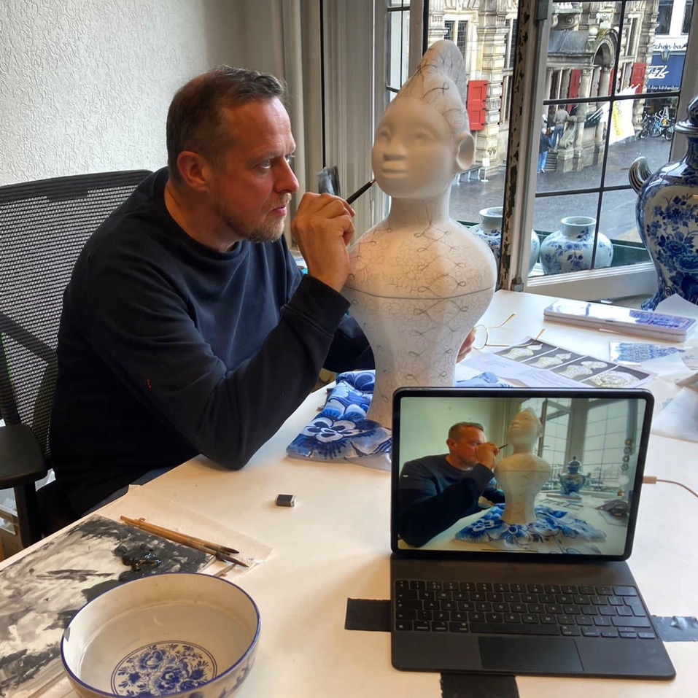
Boris van Berkum (Rotterdam - Nederland, 1968)
Boris van Berkum is een typische neo-kunstenaar, want hij combineert stijlen en vormen uit verschillende periodes, culturen
en religies tot nieuwe kunstwerken. Hij doet dit na uitgebreid onderzoek en in nauwe samenwerking met vertegenwoordigers van die culturen. Hij werkt in uiteenlopende media, keramiek en brons in combinatie met 3d-modelleringstechnieken.
Begin jaren negentig woonde van Berkum in Praag waar hij studeerde aan de Academie voor Schone Kunsten. Om zijn studie te bekostigen maakte hij politieke cartoons en illustraties voor Engelstalige kranten. Eénmaal terug in Nederland richtte Van Berkum in 1997 MAMA op, 'showroom voor media en moving art' in Rotterdam.
Van dit dynamische en vaak spraakmakende podium voor jonge kunst en cultuur was hij tot 2007 artistiek directeur.
Tijdens MAMA richtte hij samen met zijn zakenpartner Jeroen Everaert, een uitzendbureau en projectbureau voor kunstenaars op: Mothership. Hij was er mededirecteur tot 2005. Na zijn vertrek bij showroom MAMA vond Van Berkum zichzelf opnieuw uit als beeldend kunstenaar. Momenteel werkt Van Berkum aan de ABAN wintikunstcollectie, waarmee hij samen met wintipriesteres Marian Markelo de beeldende kunst traditie binnen de winticultuur nieuw leven in blaast en de essentie van winti in Nederland helpt te materialiseren en visualiseren in de meest perfect mogelijke kunst. Daarnaast is Van Berkum samen met kunstenaars Hans Muller en Dirk van Lieshout de initiatiefnemers van het Cool Clay Collective, een keramiek werkplaats door en voor kunstenaars.
De kunst van Boris van Berkum worden onder meer verzameld door het Groninger Museum en Museum Boijmans van Beuningen.
Boris van Berkum (Rotterdam - Netherlands, 1968)
Boris van Berkum is a visual artist and he is a typical neo-artist: he combines styles and forms from different periods, cultures and religions into new works of art. He does this after extensive research and in close cooperation with representatives from those cultures. He works in a wide variety of mediums, such as the traditional ceramics and bronze and the more experimental 3d-modelling techniques. In the early 1990’s van Berkum lived in Prague where he studied at the Academy of Fine Arts. To finance his studies he made political cartoons and illustrations for English language newspapers. Once back in the Netherlands, Van Berkum founded MAMA, 'showroom for media and moving art' in Rotterdam in 1997. He has been the artistic director of this dynamic podium for young art and culture until 2007.
During MAMA, together with his business partner Jeroen Everaert, he founded Mothership an employment and project agency for contemporary artists.
He was its co-director until 2005.
After leaving showroom MAMA, Van Berkum reinvented himself as a visual artist. Boris van Berkum is currently working on the 'ABAN’ art-collection, This is a collection of new winti artworks, with which he helps winti priestess Marian Markelo to revive the visual art-tradition within the winti culture and to materialize the essence of winti in the Netherlands.
Van Berkum is also co-founder of the Cool Clay Collective, a ceramics workshop by and for visual artists.
Boris van Berkum's art is collected by the Groninger Museum and Museum Boijmans van Beuningen amongst others.

Slide 2
Group-exhibitions
2022 – 2023 Unpacking Boijmans Depot Boijmans van Beuningen
curator Alexandra van Dongen
2023 Gold Afrika museum Berg en Dal curator Wouter Welling
2022 -2023 Healing Power Afrika museum curator Wouter Welling
2021 Test Lab European Ceramic Center EKWC Oisterwijk NL
curator Ranti Tjan
2021/2022 AIR in Southeast # 2020/2021 curator Renske de Jong
2021 Healing Power, Tropen Museum Amsterdam
curator Wouter Welling
2020 Permanent collection, het Dolhuys museum van de geest
2019 To Return Opposite gallery Jingdezhen
curators Liu Zongna & Song Tao (Beijing)
2019 Healing power Museum Volkenkunde Leiden
curator Wouter Welling
2018 Dutch circle of Sculptors 100 years,
Pulchri Den Haag curator Jeroen Damen
2017/2018 Sticky Business Stedelijk Museum Schiedam
curator Marije Vogelzang
2017 Making of Mama Aisa DordtYart Dordtrecht Netherlands
2016 Ritual and the Sacred Route du Nord Rotterdam
curator Hans van der Ham
2016 Hollandaise New Art Projects London UK, curator Ken Pratt
2016 Bal! Royal Palace Soestdijk Soest Netherlands
curator Anne van der Zwaag
2016 Persian Poems Seedz Rotterdam Vluchtelingenwerk Nedereland
2015 Diversity and Inclusion: Challenging Implicit Bias –
University Leiden curator CBK Zuidoost Amsterdam
2015 Arte Concordia – Sculpture exhibition Rotterdam
curator Olpheart den Otter
2015 MOM contemporary masks
Centrum Beeldende Kunst Zuid Oost Amsterdam
2014 Goethe Dialegs Goethe Institut Barcelona Spain
curator Robert Punkenhofer
2014 The Individual Is Lost Zic Zerp Gallery Rotterdam
2014 Down to Earth gallery Sanaa Utrecht
2013 Catch my Drift Zic Zerp gallery Rotterdam
2013 Slavery - contemporary arts included?
Galerie Sanaa Utrecht
2013 Digitale Kunstroof/ Digital Art Heist
3d-printing Set-up/ het gebouw Utrecht
2012/2013 Abundantia Museum Boijmans Van Beuningen curator Peter van der Coelen
2012 Raw Art Expo, Raw Art Fair Rotterdam curator Bob Smit
2012 The Kids Are Alright, 15 years MAMA, Kunsthal Rotterdam curator Gerben Willers
Public collections
Museum Boijmans van Beuningen Rotterdam,
Groninger Museum, Museum Het Dolhuys Haarlem, Kunstuitleen Rotterdam, Dutch Ministry of Justice,
Dutch Ministry of Foreign affairs, Amsterdam Museum,
Suriname Museum Paramaribo
Public Art
2002 Ode aan Marten Toonder,
Binnenrotte Rotterdam, commissioner City of Rotterdam
Artist in residencies
2021/ 2022 EKWC European Ceramic Work Center,
Oisterwijk (ceramics)
2020 Heinen Delftsblauw Putten (ceramics)
2019/2020 BijlmAIR Amsterdam Zuid-oost (research)
2019 NA artist in residency Jingdezhen China (porcelain)
2016 Paradise Tiles Isfahan Iran (mosaic, tiles & calligraphy)
2015 Pottery Workshop Jingdezhen China (porcelain)
2014 EKWC European Ceramic Work Center, Den Bosch (ceramics)
2010 EKWC European Ceramic Work Center, Den Bosch (ceramics)
2007 Beeldenstorm / Make Eindhoven (bronze)
2002 EKWC European Ceramic Work Center Den Bosch (ceramics)
Curriculum vitae
Boris van Berkum (Rotterdam 1968)
lives and works in the Netherlands
Education
1992-1993 Academy Umeni Vitvarny (Academy for Fine Arts)
Prague Czech Republic
1988-1989 Willem de Kooning Academy Rotterdam
1980-1998 Montessori Lyceum Rotterdam Gymnasium
Cultural management
2022 present - Cool Clay Collective foundation
founder, member executive committee
2014- present Winti Bal Masqué creative director
2000-2005 Mothership founder, CEO & owner partnership
1997-2007 MAMA showroom for Media and Moving Art Rotterdam
founder & director
Solo- exhibitions
2021 Snake Charmer Hilton Art lab Rotterdam
2021 Snake Charmer Object Rotterdam
curator Anne v d Zwaag
2018 AFRICA not African? drawings & silkscreens
Upstair’s at Erix Berlin, curator Eric D. Clark
2014 Kabra mask exhibition Amsterdam Museum curator Annemarie de Wildt
2014 Mama Aisa XXXL central library Rotterdam
2011 Mega-renaissance Museum Boijmans Van Beuningen
curator Sjarel Ex
2010 Recent works Witzenhausen gallery

Slide 3
Curriculum vitae Boris van Berkum
Performances
2023 October Winti Bal Masqué 2 Theater Rotterdam
2022 inauguration Kabra blauw lidded pot depot Boijmans van Beuningen
2019 - present Memri Waka Amsterdam,
performance Kabra mask initiative of the Amsterdam Museum
2013- present Kabra ancestor dance-mask Libation,
National Commemoration of Slavery, Oosterpark Amsterdam.
2013- present performance Kabra mask Kabra Neti,
winti ancestor ritual Muiderkerk Amsterdam
2013-2017 mask-dance Keti Koti celebration Afrika Museum
2015-2016 Kabra mask 40 performances
Wijksafari Bijlmer Adelheid Roosen Amsterdam,
2015 Afrofuturism Now – Worm Rotterdam NL
2014 Papa winti mask-dance
Witte de With art-festival Rotterdam
2014 Kabra mask-dance at Kabra Neti
winti ancestor ritual, Sunclub Rotterdam
2014 mask-dance Motel Mozaique Rotterdamse Schouwburg
2014 Winti Bal Masqué Laurenskerk Rotterdam
Grands
2021 Stimuleringsfonds Project grand Vormgeving
2021 Droom en Daad Project grand Makers loket
2019- 2023 Mondriaanfonds Stipendium for Established Artists
2019 Fonds Kwadraat
2016 Art of Impact development grand
(Ministry Education Culture & Science)
2016 Mondriaanfonds Project grand
2016 CBK Rotterdam Project grand Research and Development
2015 Mondriaanfonds Project grand residency Iran Isfahan
2014 Mondriaan fund Project grand
2013 Fonds 21 Project grand
2013 CBK Rotterdam development grand
2013 Mondriaanfonds Project grand
Catalogues and publications
2022 Happinez 8 pages about winti & the aban winti art collection
2021 De (weder-) geboorte van Mama Aisa
essay author Bart Krieger, Freelance curator
2021 Metamorfosen essay author Alexandra van Dongen, conservator Preindustrial design Museum Boijmans Van Beuningen Rotterdam
2021 Healing power exhibition catalogue Museum van Wereldculturen author Markus Balkenhol, publisher Sidepress
2019 My Afternoon with an Alien Folk Artist essay by Darius James
2017 Neo Afro in Afrofuturism,
essay by Aminata Cairo & Jeroen Deckers publisher Punt Komma
2016 Afrikaanse renaissance author dr. Paul Faber article
exhibition-catalogue Arika 010 Wereldmuseum
2016 Paleis Soestdijk door de ogen van kunstenaars
review group expo Bal! Volkskrant author Anne v Leeuwen
2015 Mask-dancing in contemporary Winti ritual Material Religion Journal, author dr. Markus Balkenhol Meertens instituut
2015 Negotiations around the Kabra mask Material Religion Journal, author Annemarie de Wildt conservator Amsterdam Museum
2015 Winti Kabra and the Limbo imagination Material Religion Journal
author Wayne Modest director Museum van Wereldculturen, professor Faculty of Humanities Vrije Universiteit Amsterdam.
2015 The Dancing Kabra Mask Africanah.org author Annemarie the Wildt conservator Amsterdam Museum
2013 Sweet Sixteen 16 years showroom MAMA, Showroom MAMA
2012 City Collection catalogue, Museum Boijmans van Beuningen
2012 Top 100 Dutch Artists, Elsevier magazine
2011 Mega Renaissance catalogue Museum Boijmans Van Beuningen
2011 Mega Renaissance Exhibition review Museum Boijmans,
Ceramics & perception magazine US
Television
2022 Report inauguration Kabra Blauw dekselpot in Depot Boijmans van Beuningen OPEN local tv station
2019 Iedereen Verlicht NTR program about spirituality in the Netherlands
2017, 2018, 2019, 2020, 2022 NTR Report National commemoration abolishment of Slavery (National Dutch broadcast)
2013 NTR Report National commemoration abolishment of Slavery (National Dutch broadcast)
Documentary
2023 Free space NTR documentary Uur van de Wolf dir. Karen Junger
2021 Kabra Blauw the making of an object of desire dir. Marieke van der Lippe
2021 Behind the Kabra Mask, director Marieke van der Lippe, ABAN foundation
2018 Drie vrouwen, director Ida Does NTR
2011 Moving Statues Arttube Boijmans TV, video-interview artist Boris van Berkum
Art-talks & Lectures
2022 public lecture about Kabra blauw
with Alexandra van Dongen curator Boijmans
2022 Kabra Blauw and Mama Aisa lecture, couse: the anthropology of art and material culture. University college Universiteit Utrecht with Dr. Markus Balkenhol Meertensinstituut & Marleen de Witte
2021 Crash Course: Media Art & Sculpture V_2 Rotterdam
2019 Ode aan Marten Toonder Lecture Rotary Club Rotterdam
2017 The Making of Mama Aisa Dortyart Dordrecht with Noraley Beyer
2017 Afrika 010 curator Paul Faber Afrika 010 Wereld Museum Rotterdam
2017 Artist practice BKAdemie Rotterdam
2016 workshop WdKA art academy Rotterdam
2015 Pecha Kucha Arminius Rotterdam
2014 about the Kabra mask Amsterdam Museum Amsterdam

